Slide 2

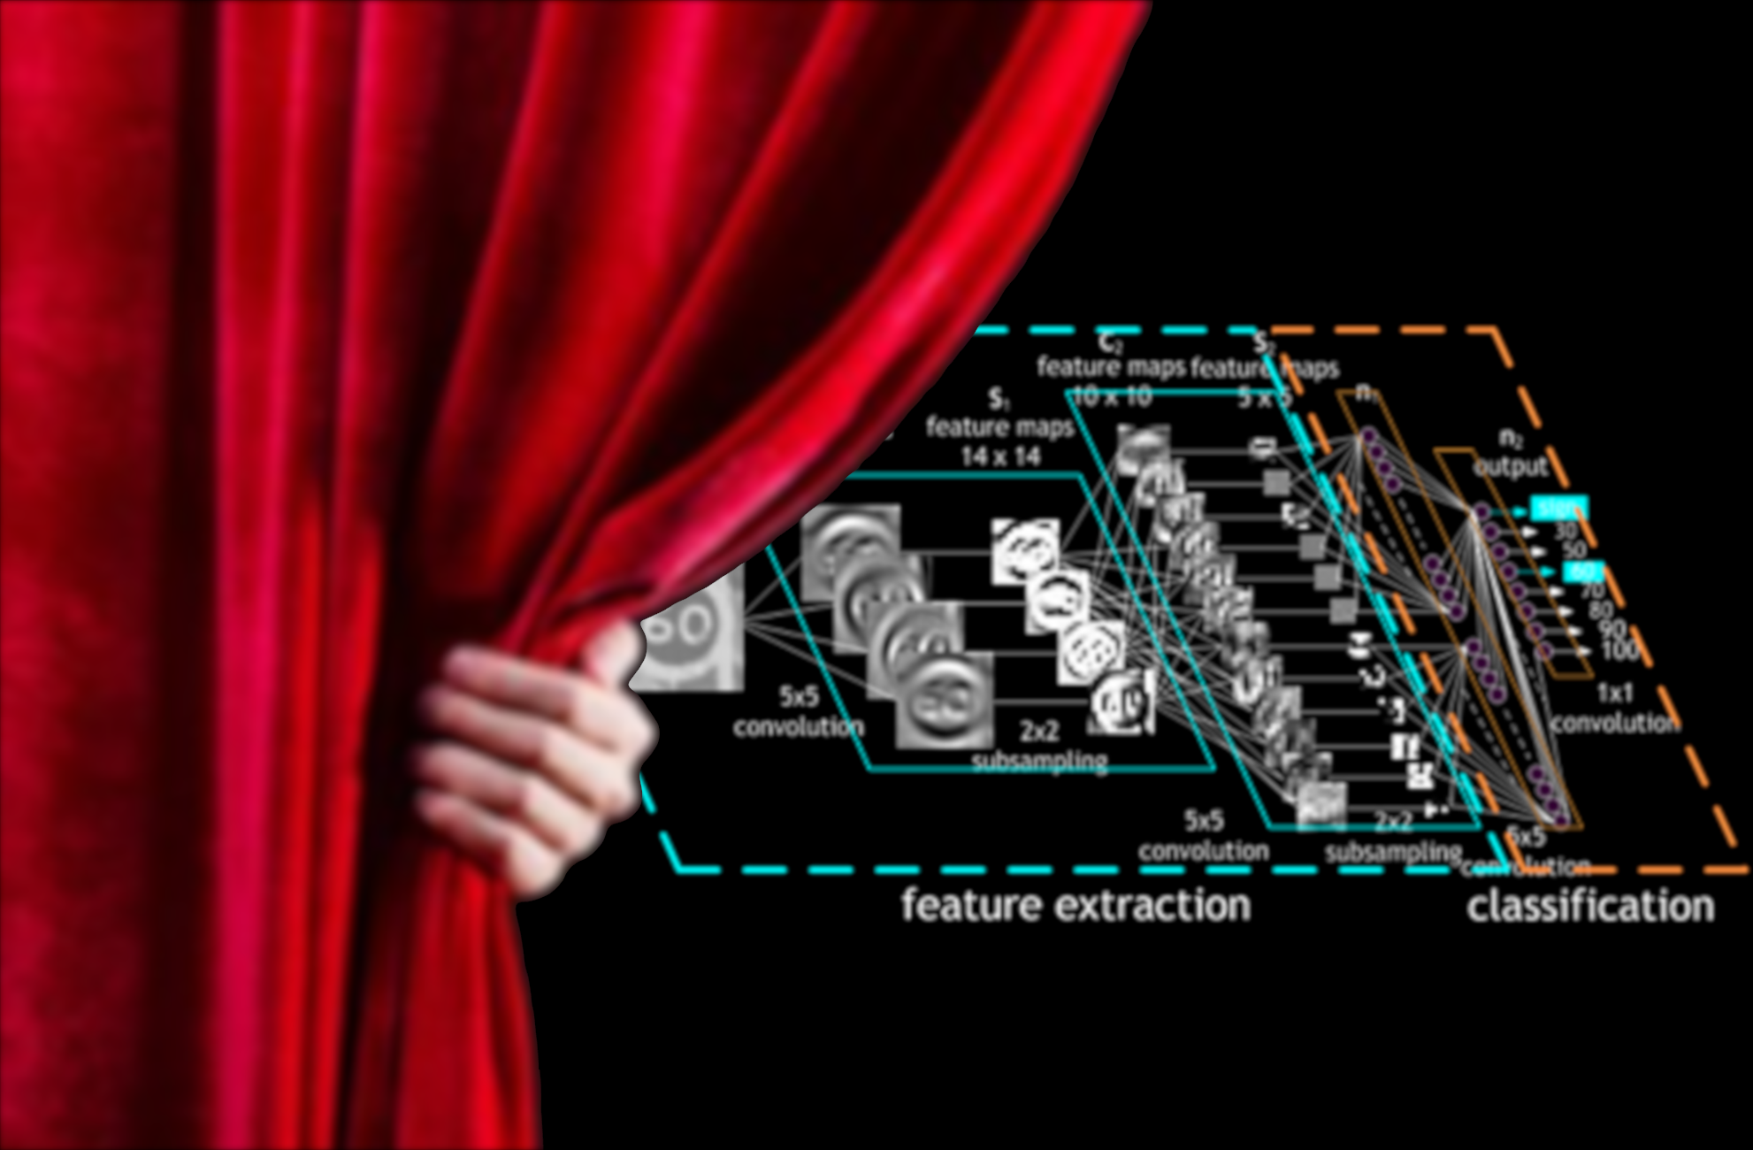
CONVOLUTIONAL NEURAL NETWORKS
ENGINEERING MACHINE LEARNING
HEALTH TECHNOLOGY

Slide 3
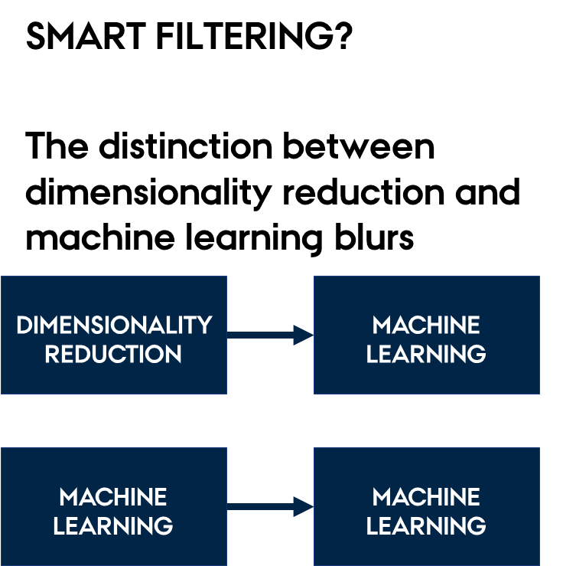

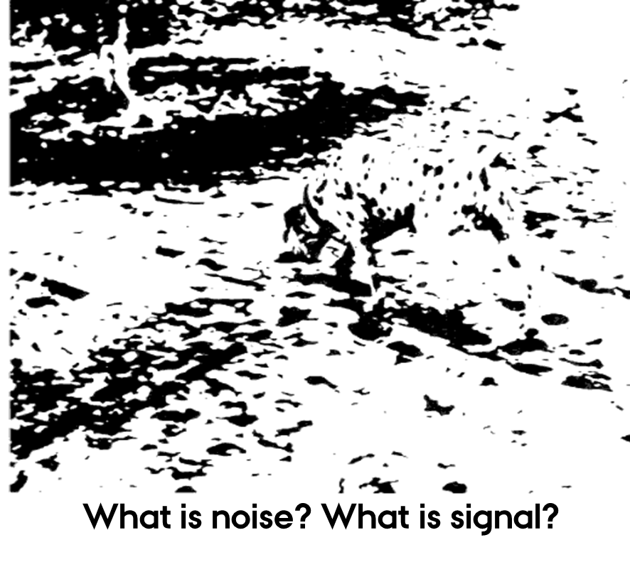
CONVOLUTIONAL NEURAL NETWORKS
FEATURE EXTRACTION VERSUS FEATURE LEARNING

Slide 4

CONVOLUTIONAL NEURAL NETWORKS
FEATURE EXTRACTION VERSUS FEATURE LEARNING

Slide 5
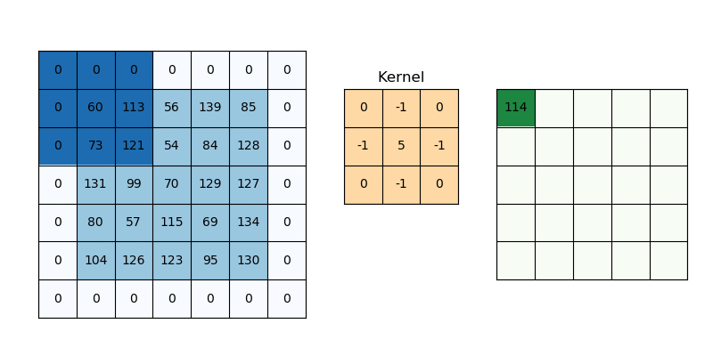
CONVOLUTIONAL NEURAL NETWORKS
CNN ARCHITECTURE – 2D CONVOLUTION

Slide 6

CONVOLUTIONAL NEURAL NETWORKS
CNN ARCHITECTURE – 2D CONVOLUTION

Slide 7
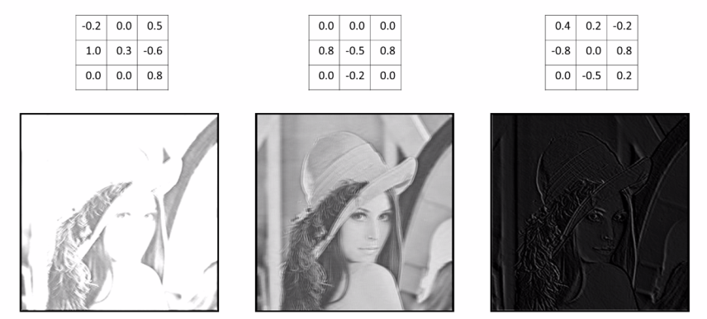
CONVOLUTIONAL NEURAL NETWORKS
CNN ARCHITECTURE – 2D CONVOLUTION
https://medium.com/analytics-vidhya/deep-learning-methods-1700548a3093

Slide 8
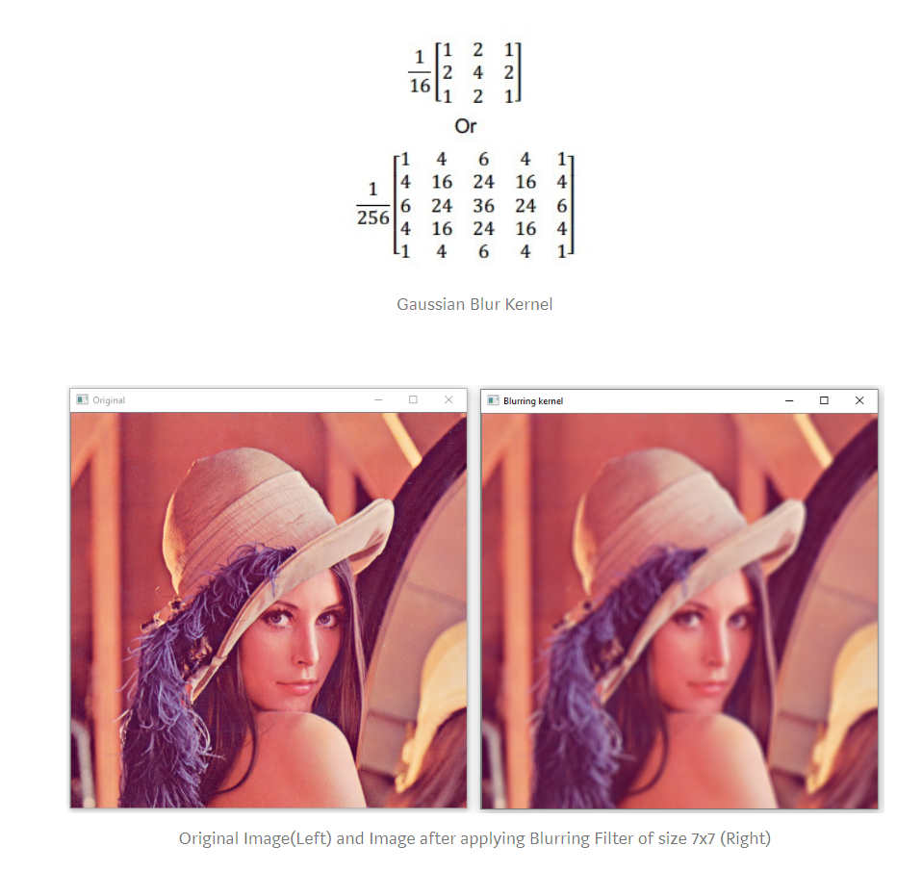
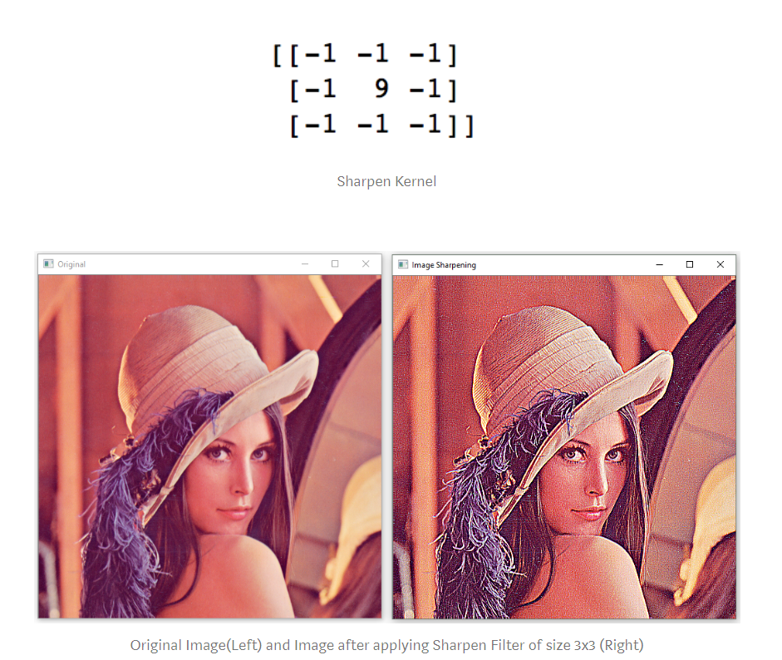
CONVOLUTIONAL NEURAL NETWORKS
CNN ARCHITECTURE – 2D CONVOLUTION

Slide 9
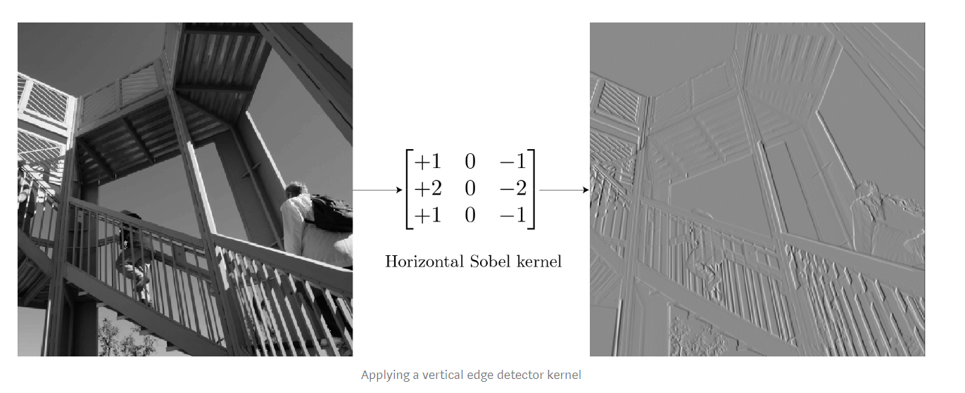
CONVOLUTIONAL NEURAL NETWORKS
CNN ARCHITECTURE – 2D CONVOLUTION

Slide 10

CONVOLUTIONAL NEURAL NETWORKS
CNN ARCHITECTURE – ‘3D CONVOLUTION’

Slide 11
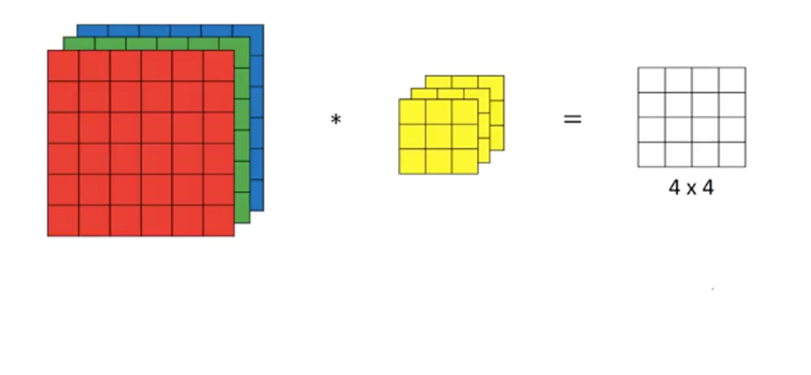
CONVOLUTIONAL NEURAL NETWORKS
CNN ARCHITECTURE – ‘3D CONVOLUTION’
OBS: Slide only in 2D

Slide 12
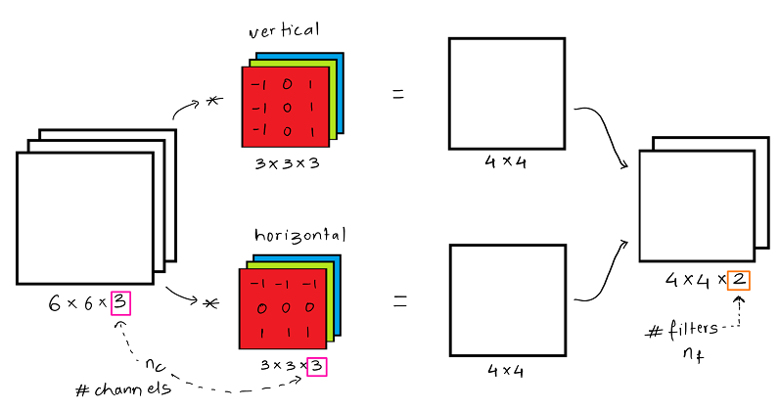
CONVOLUTIONAL NEURAL NETWORKS
CNN ARCHITECTURE – FILTER BANKS
https://towardsdatascience.com/convolutional-neural-network-ii-a11303f807dc

Slide 13
CONVOLUTIONAL NEURAL NETWORKS
CNN ARCHITECTURE – FILTER BANKS / ‘3D CONVOLUTION’

Slide 14
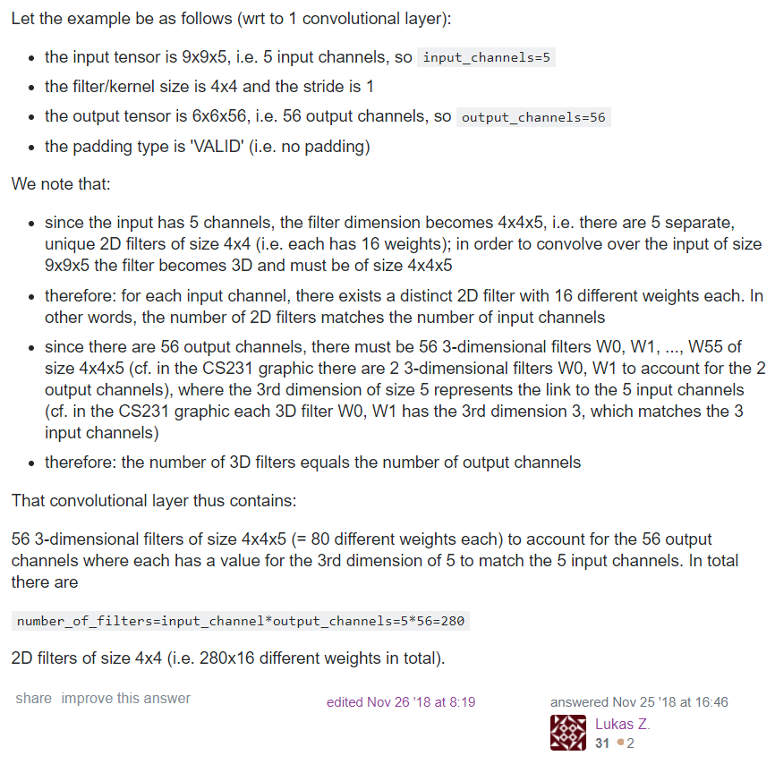
CONVOLUTIONAL NEURAL NETWORKS
CNN ARCHITECTURE – ‘3D CONVOLUTION’

Slide 15
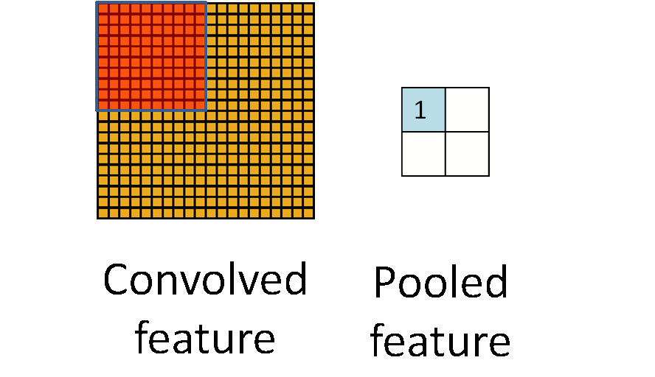
CONVOLUTIONAL NEURAL NETWORKS
CNN ARCHITECTURE - POOLING

Slide 16
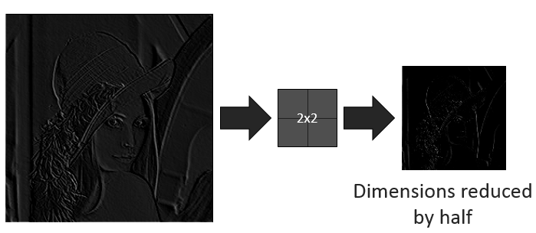
CONVOLUTIONAL NEURAL NETWORKS
CNN ARCHITECTURE - POOLING
https://medium.com/analytics-vidhya/deep-learning-methods-1700548a3093

Slide 17
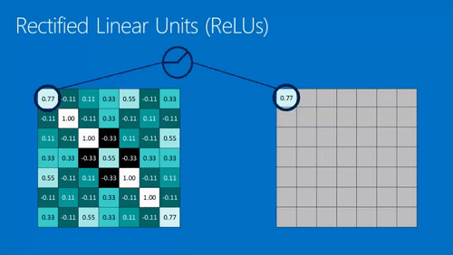
CONVOLUTIONAL NEURAL NETWORKS
CNN ARCHITECTURE - ReLU

Slide 18
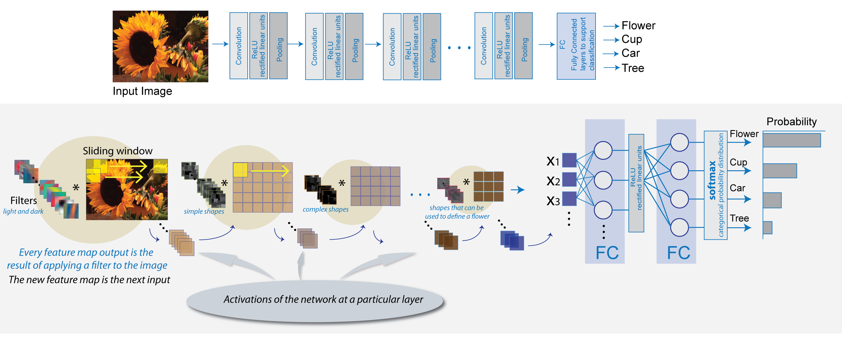
CONVOLUTIONAL NEURAL NETWORKS
CNN ARCHITECTURE – LAYERS OF ABSTRACTION

Slide 19
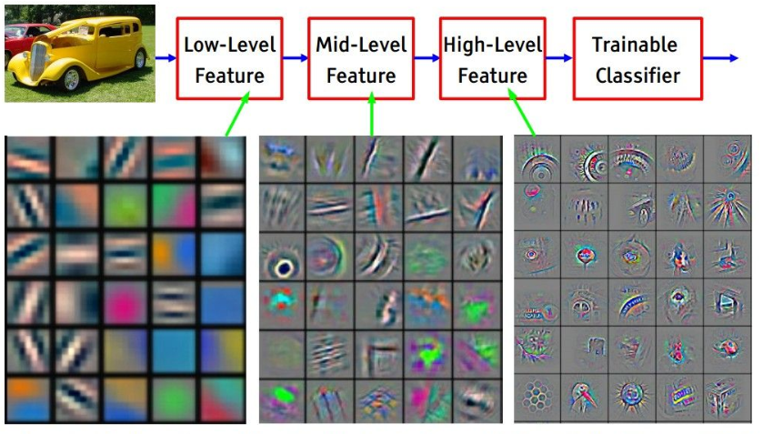
CONVOLUTIONAL NEURAL NETWORKS
CNN ARCHITECTURE – LAYERS OF ABSTRACTION

Slide 20
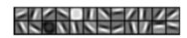
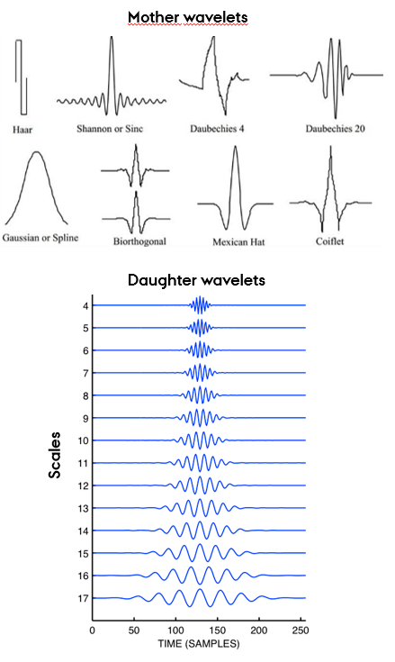
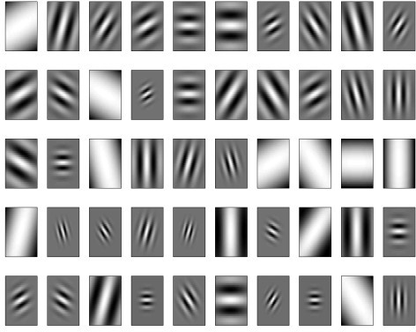
CONVOLUTIONAL NEURAL NETWORKS
CNN ARCHITECTURE – FILTER INITIALIZATION

Slide 21

CONVOLUTIONAL NEURAL NETWORKS
CNN ARCHITECTURE – FILTER INITIALIZATION

Slide 22
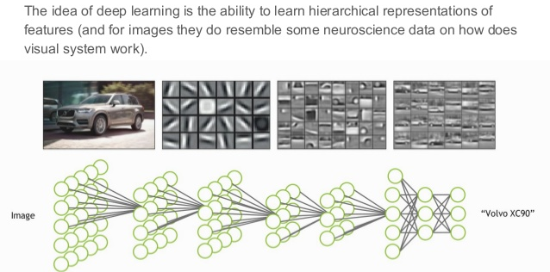
CONVOLUTIONAL NEURAL NETWORKS
RECEPTIVE FIELDS IN CNN AND THE BRAIN

Slide 23
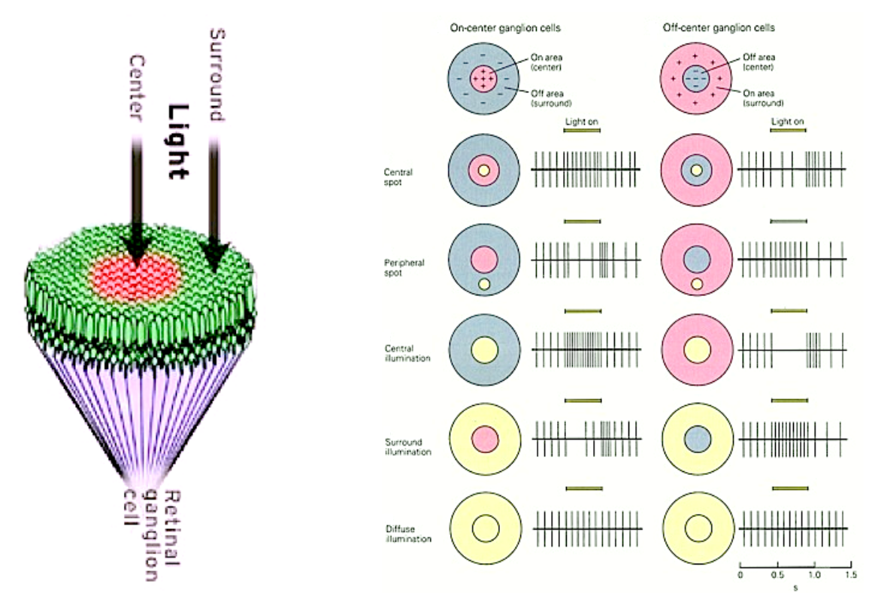
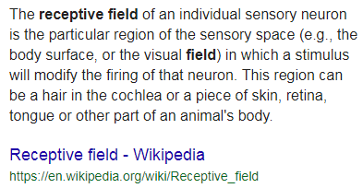
CONVOLUTIONAL NEURAL NETWORKS
RECEPTIVE FIELDS IN THE BRAIN

Slide 24
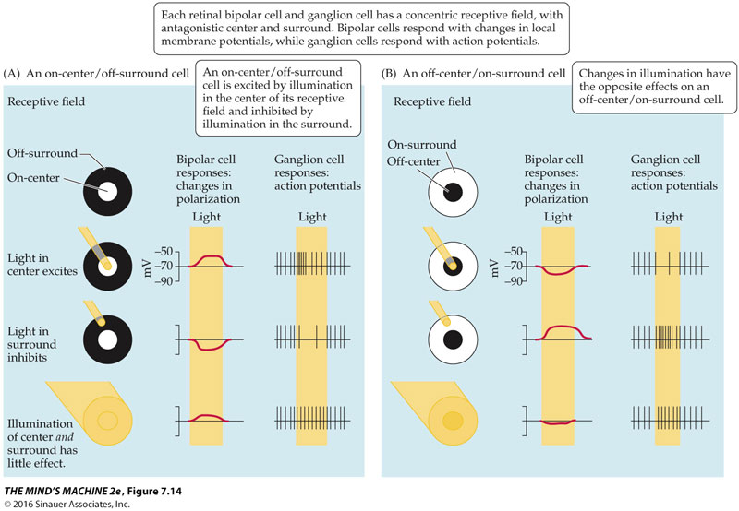
CONVOLUTIONAL NEURAL NETWORKS
RECEPTIVE FIELDS IN THE BRAIN

Slide 25
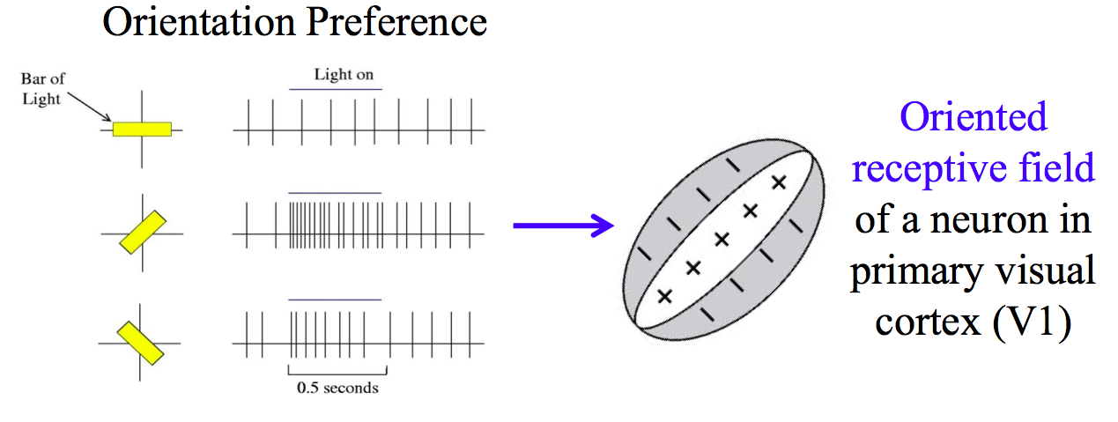
CONVOLUTIONAL NEURAL NETWORKS
RECEPTIVE FIELDS IN THE BRAIN

Slide 26
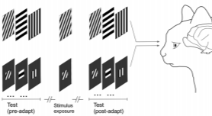
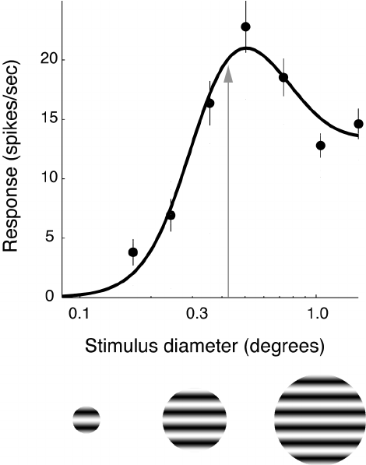
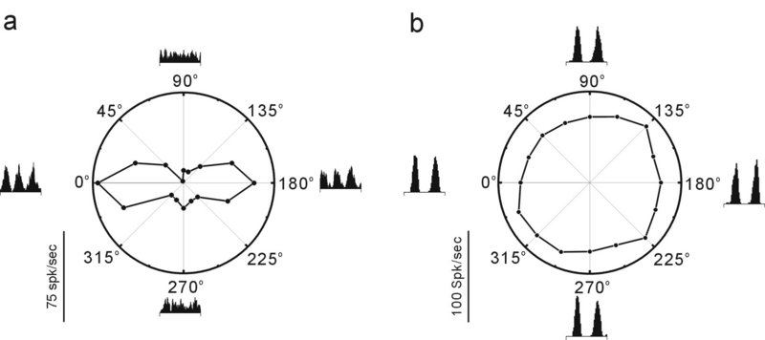
CONVOLUTIONAL NEURAL NETWORKS
RECEPTIVE FIELDS IN THE BRAIN

Slide 27
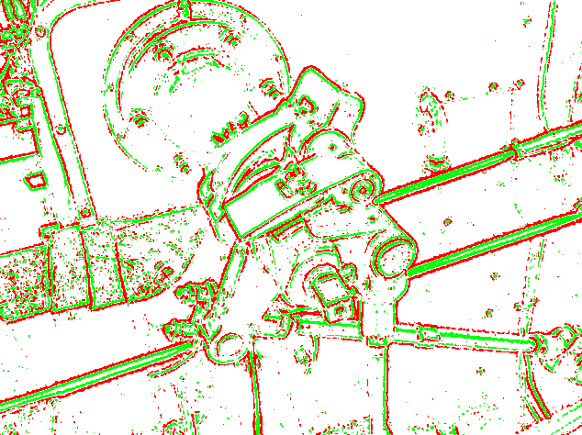
CONVOLUTIONAL NEURAL NETWORKS
RECEPTIVE FIELDS IN THE BRAIN

Slide 28
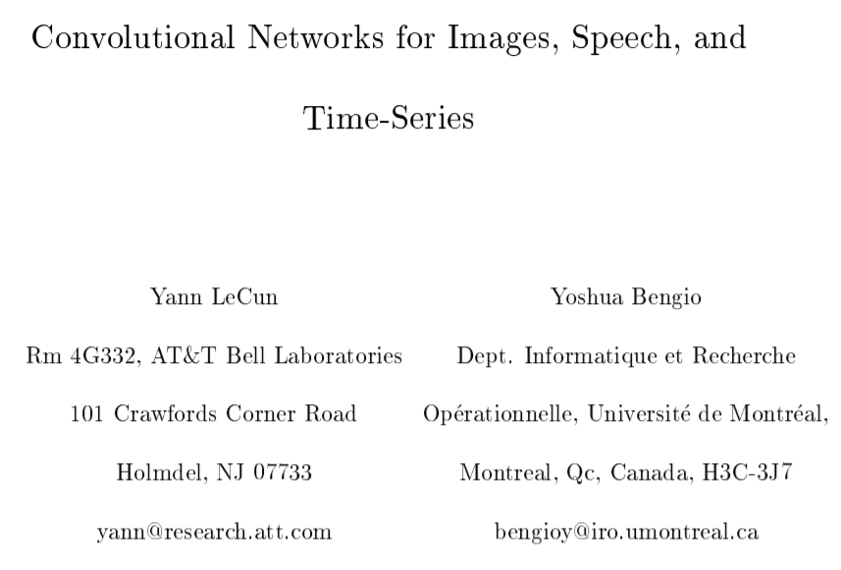
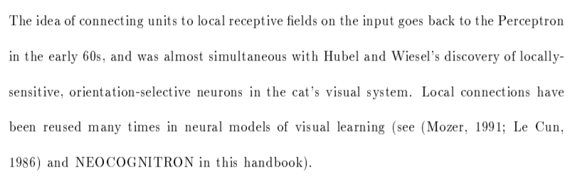
CONVOLUTIONAL NEURAL NETWORKS
DID RECEPTIVE FIELDS REALLY INSPIRE CNN?
2D convolution with kernels certainly existed before the discovery of receptive fields.
And were used in machine learning at about the same time.
It’s just filtering.
What seems inspired is learning the best filters, but was that inspired by the brain?

Slide 29
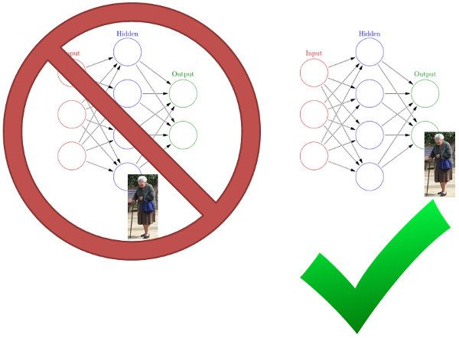
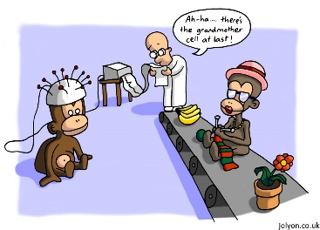
CONVOLUTIONAL NEURAL NETWORKS
DID RECEPTIVE FIELDS REALLY INSPIRE CNN?
The grandmother cell

Slide 30
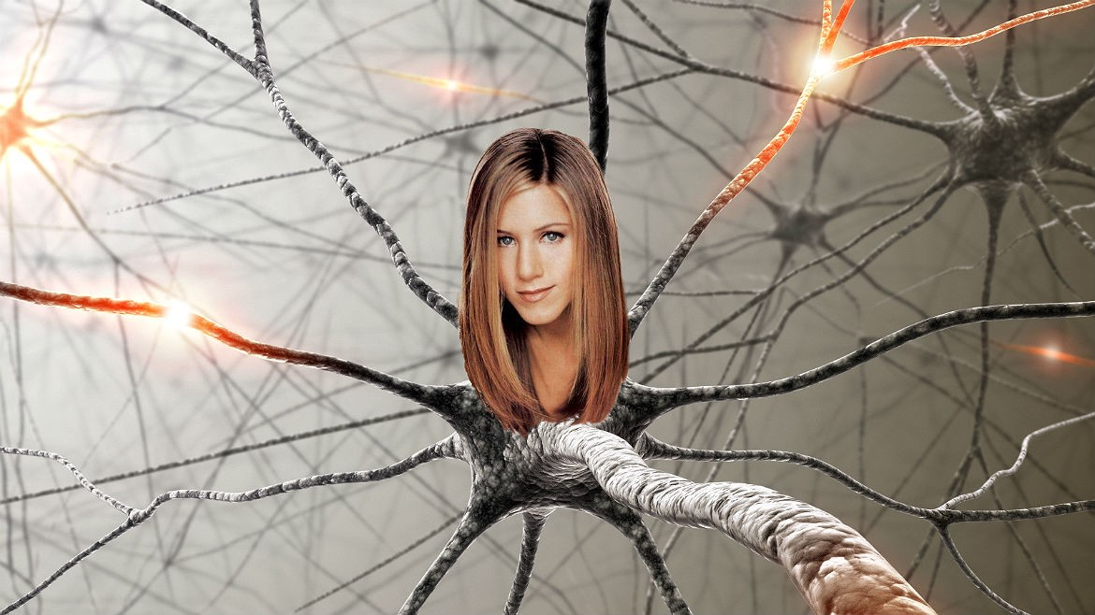
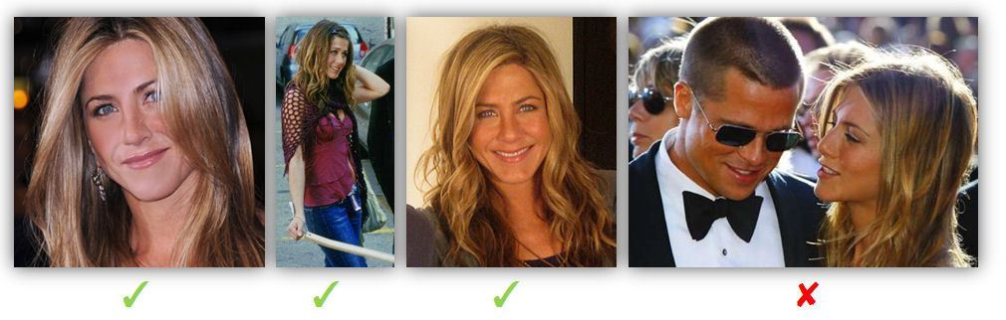
CONVOLUTIONAL NEURAL NETWORKS
DID RECEPTIVE FIELDS REALLY INSPIRE CNN?
The Jennifer Aniston cell

Slide 31
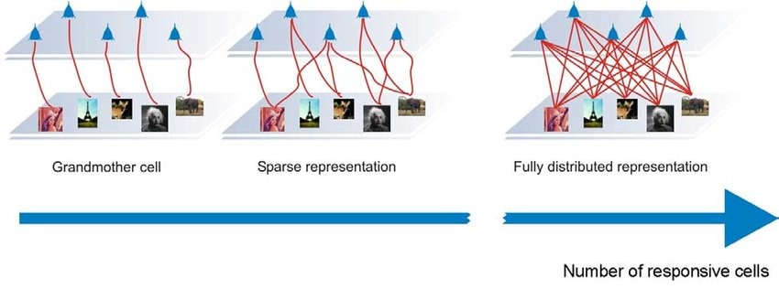
CONVOLUTIONAL NEURAL NETWORKS
DID RECEPTIVE FIELDS REALLY INSPIRE CNN?
The Jennifer Aniston cell – how likely are you to find it?

Slide 32
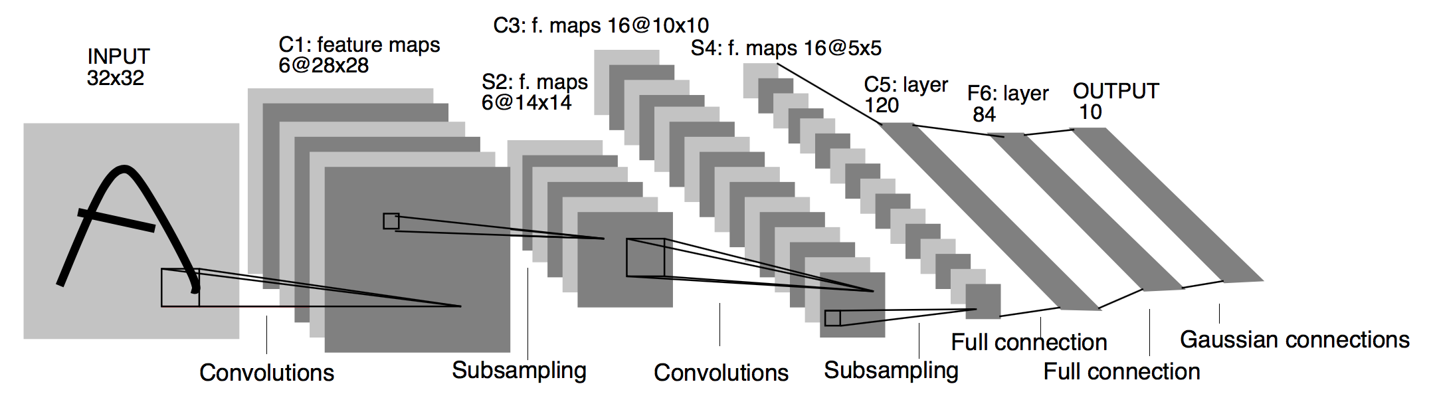
CONVOLUTIONAL NEURAL NETWORKS
LeNET-5 ARCHITECTURE
Original Image published in [LeCun et al., 1998]

Slide 33
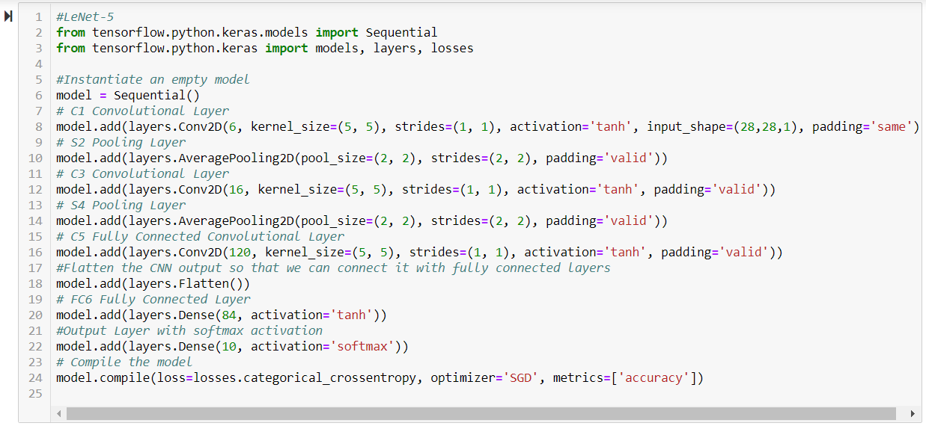
CONVOLUTIONAL NEURAL NETWORKS
LeNET-5 IN KERAS
Adapted from https://engmrk.com/lenet-5-a-classic-cnn-architecture/

Slide 34
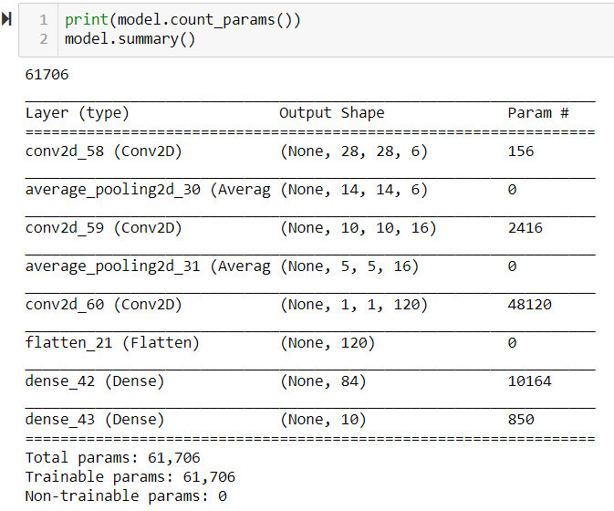
CONVOLUTIONAL NEURAL NETWORKS
LeNET-5 IN KERAS
Trainable parameters in layer =
(No._filters_in * kernel_size + bias) * No._filters_out
Conv Layer 1 = (1*5*5+1)*6 = 156
Conv Layer 2 = (6*5*5+1)*16 = 2416
Conv Layer 3 = (16*5*5+1)*120 = 48120

Slide 35
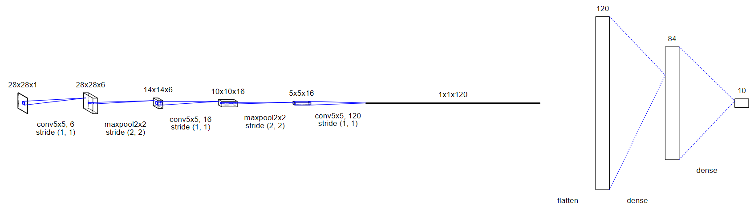
CONVOLUTIONAL NEURAL NETWORKS
LeNET-5 IN KERAS

Slide 36
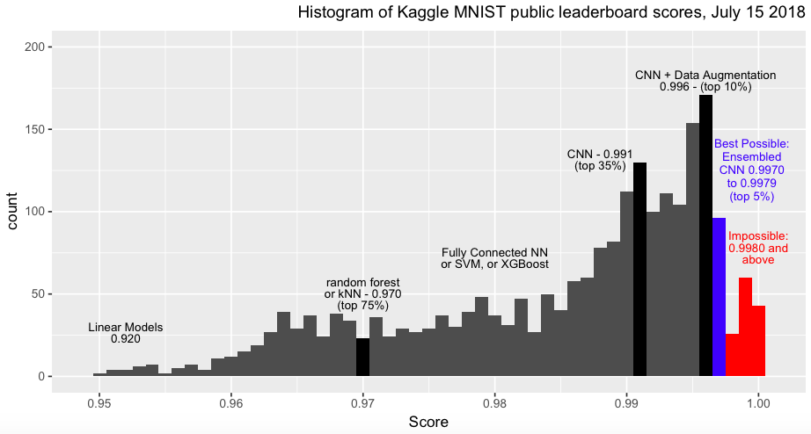
CONVOLUTIONAL NEURAL NETWORKS
LeNET-5 IN KERAS ON MNIST
ITMAL GRUPPE 10

Slide 37
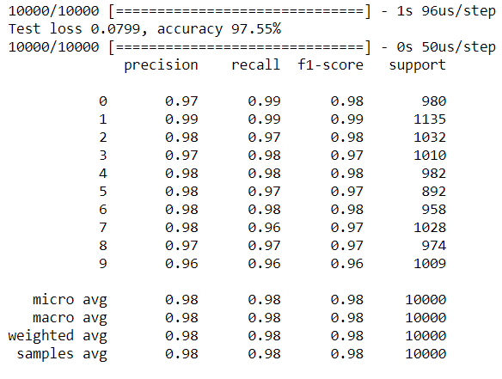
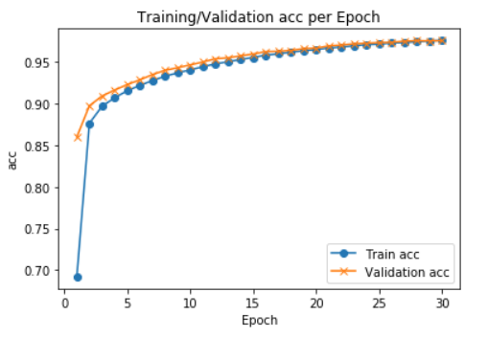
CONVOLUTIONAL NEURAL NETWORKS
LeNET-5 IN KERAS ON MNIST

Slide 38
CONVOLUTIONAL NEURAL NETWORKS
LeNET-5 IN KERAS ON MNIST

Slide 39
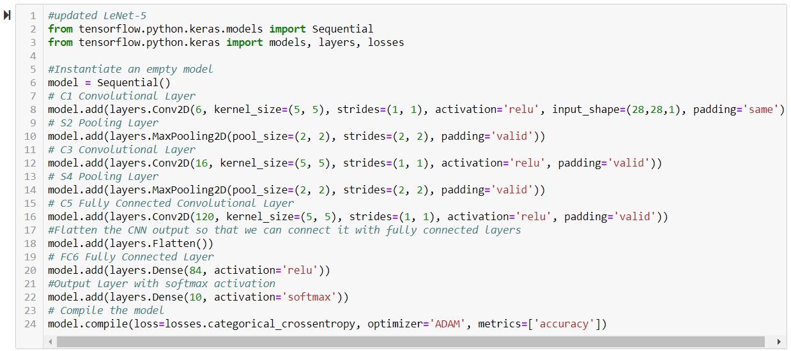
CONVOLUTIONAL NEURAL NETWORKS
UPDATED LeNET-5 IN KERAS ON MNIST

Slide 40
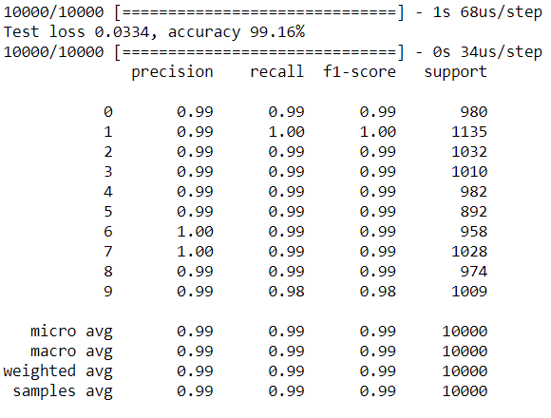
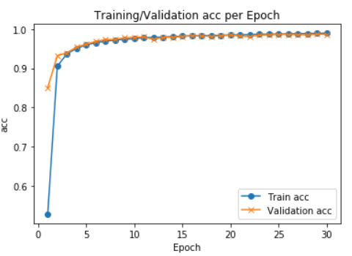
CONVOLUTIONAL NEURAL NETWORKS
UPDATED LeNET-5 IN KERAS ON MNIST

Slide 41
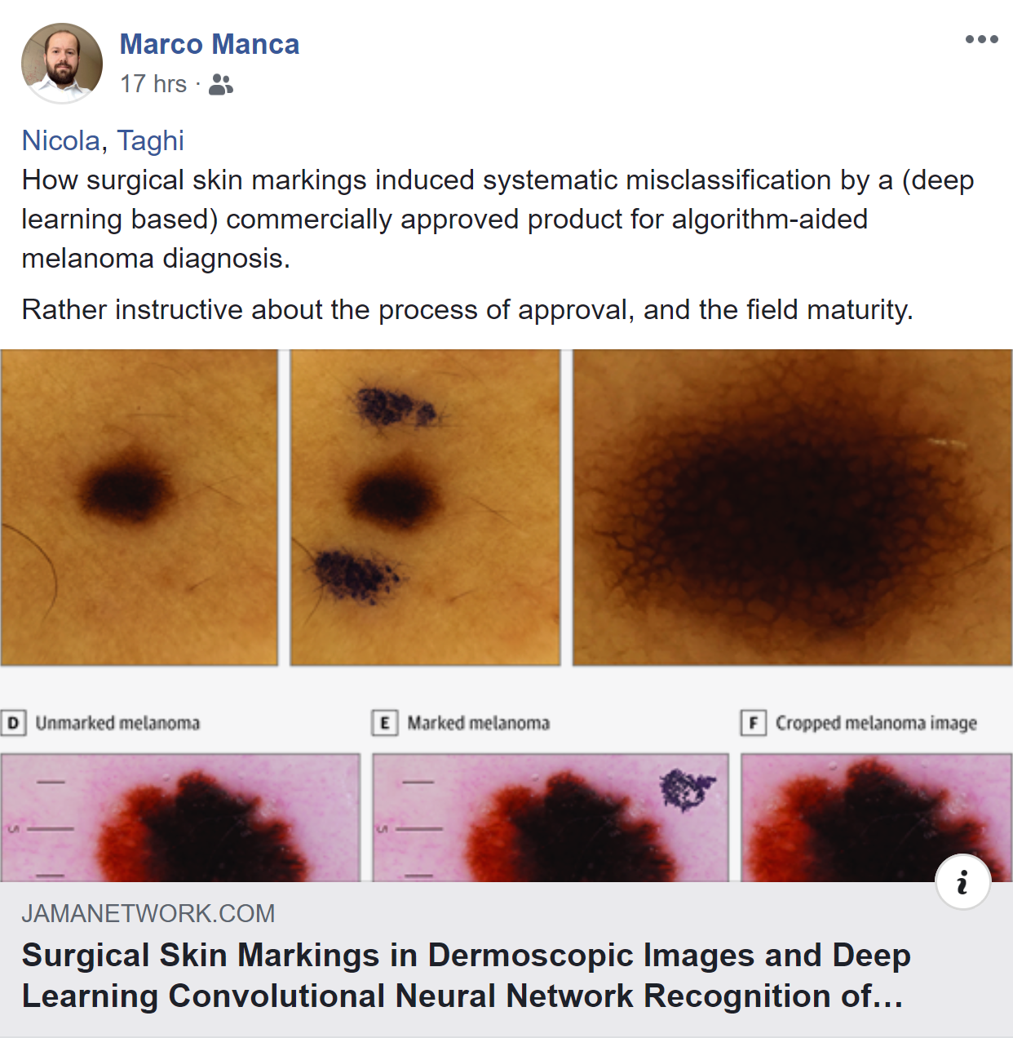
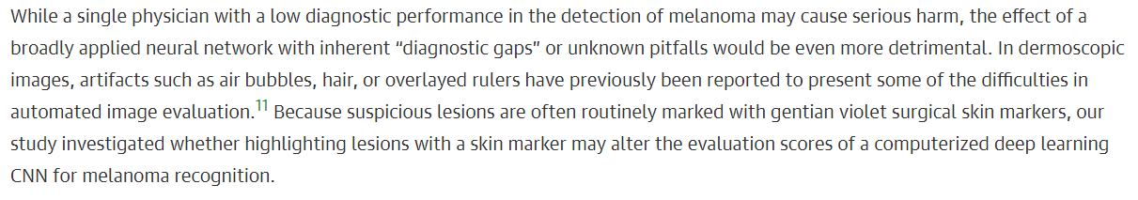
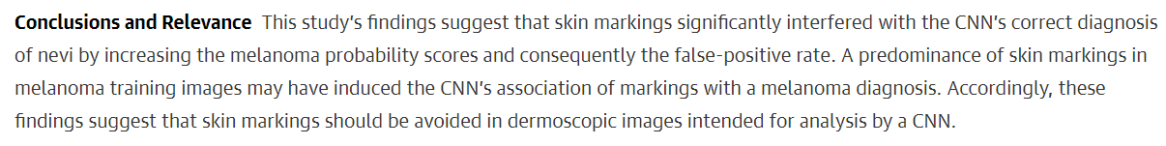
CONVOLUTIONAL NEURAL NETWORKS
WARNING

